Slide 1

01
TOPCon technology introduction
02
N-TOPCon advantages
CONTENTS
03
High value return of TOPCon modules
04
Jolywood TOPCon products

Slide 2
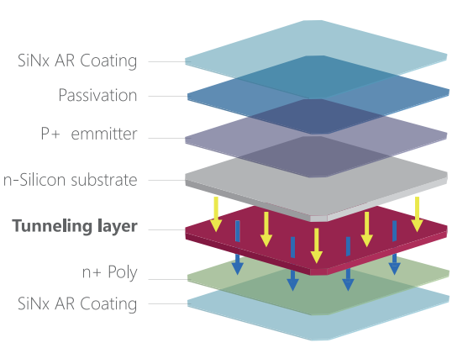
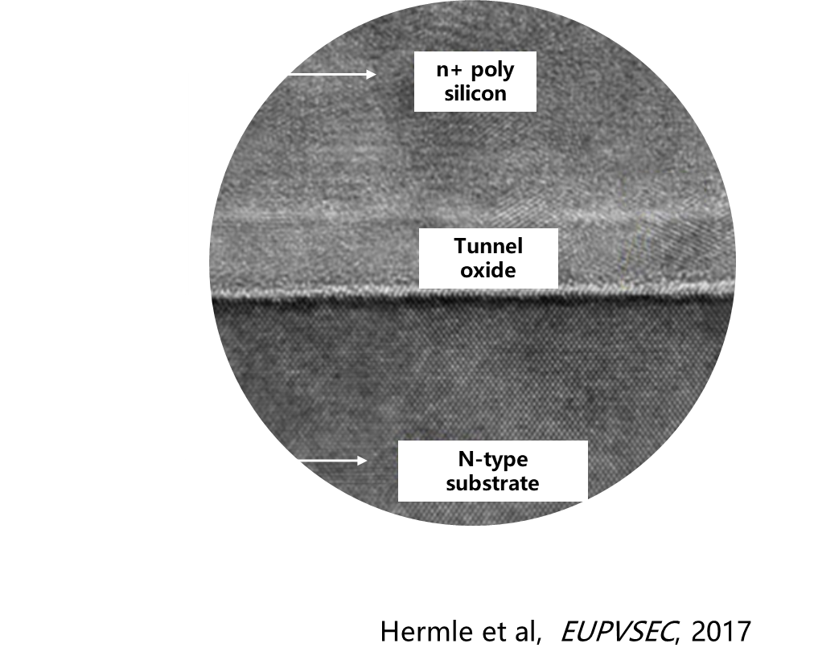
TOPCon technology introduction
Quantum tunneling effect: The quantum behavior of microscopic particles such as electrons that can penetrate or pass through a potential barrier
TOPCon- Tunnel Oxide Passivating-contact
2
Notes:
Firstly, I will say something about the cell structure. The outermost layer is silicon nitride, which is used as anti- reflection film, this film also has a chemical passivation function. The next is aluminum (/əˈluːmɪnəm/) oxide film, This film provides another passivation to let the minority (/maɪˈnɒrəti/) carrier or called hole, life longer. The significant characteristic of Topcon is it has an extreme thin tunnel oxide film, which is about only 1nm~2nm(nanometer). In fact, it is a silicon nitride film, playing a role to let the majority carriers (electron) pass through, meanwhile hold back the minority carriers (hole), thus the surface recombination can be reduced, which significantly improves the cell open voltage (/ˈvəʊltɪdʒ/), leading the cell efficiency increasing. The next deposition beside tunnel oxide is a doped poly-silicon film, the direct contact between wafer surface and mental grid can be avoided, thus means the recombination caused by mental contact is decreased. In addition, the N type silicon has more tolerance to impurity than P type silicon, so the minority carrier life is longer. In brief, due to the structure difference and optimization, the power of the Topcon module is normally 10~15W more than perc module with some module tructure.

Slide 3
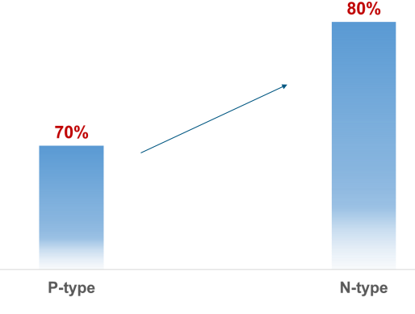
TOPCon advantages- Bifaciality
Compared with PERC, the bifaciality of TOPCon modules can reach up to 80%
3
Notes:
OK, we come to the advantages, firstly, bifacial rate.
The baficiality of Topcon is normally 80%, which is much higher than perc, only 70%. So, the generation power is improved.

Slide 4
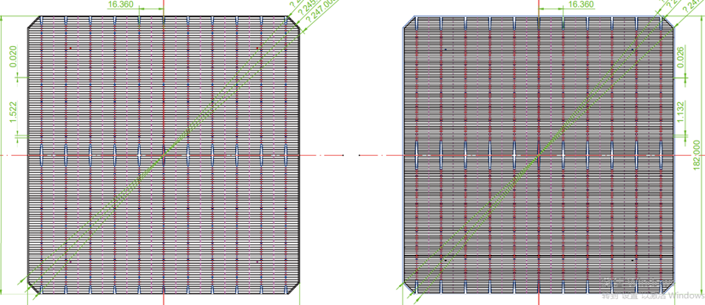
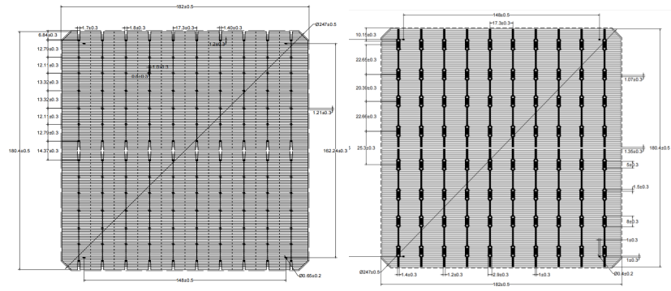
TOPCon advantages- Bifaciality
Front
Back
TOPCon drawing
Front
Back
PERC drawing
4
Notes:
Why Topcon has higher baficiality
1. Better Weak Illumination Response, when the light is weak, more electricity can be generated by N type cells. And for this matter, I will explain in the following slides.
2. The structure. The backside of Topcon cell is silver(/ˈsɪlvə(r)/), due to the electron is collected by the backside grid, so the conductor with better performance should be applied on the backside, that is why silver is necessary. However, for perc cell, the electrons are gathered in the front side, so the backside gird is aluminum, the conduct performance is less than silver. Additionally, as can be seen on the pictures, the backside grid of perc is large than the Topcon, because when the cross section is bigger, the conductive performance will be better. Therefore, more cell area of the backside is covered, thus leading to less light absorption. In brief, more light absorption and stronger conductivity enable the bifacial rate of Topcon modules better.

Slide 5
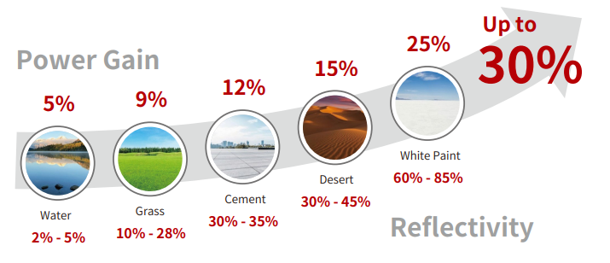
TOPCon advantages- Bifaciality
Take full advantages of high bifacial rate- Albedo
5
Notes:
Next, what benefits can high bifaciality of Topcon module bring us? From this grapy ,we can see as the albedo of the ground rising, the extra power from the back side will improve. For some extreme condition, such as white paint ground, the extra power from the backside can reach to 25%.

Slide 6
TOPCon advantages- Bifaciality
6
Notes:
This picture shows the power gain when compared with perc bifaciall modules, the Topcon can take for us. When albedo is 10%, such as water. 0.47% extra power is acquired. For PV plants in desert, the albedo of sand is about 35%, thus, the increase can be over 1%. Therefore, as the albedo arising, the performance of the backside will be better.

Slide 7
TOPCon advantages- Low temperature coefficient
N type module temperature coefficient：-0.30%/℃
P type module temperature coefficient ：-0.35%/℃
560
526.4
1.08%
-0.3%/℃
Power (W)
Assume the operation temperature of 560Wp module is 45℃
Output of N type module：526.4W
Output of P type module：520.8W
Power gain：1.08%
520.8
459.2
-0.35%/℃
3.8%
442.4
25
35
45
55
65
75
85
Module temperature
Under high temperature environment, the benefit will expand to 3.8%
7
Notes:
After the high bifacial rate advantage, lower temperature coefficient is also significant for solar modules.
The the solar cells are made of crystalline silicon, duo to its material characteristic, if the temperature is higher, performance will be lower. The temperature coefficient is applied to calculate the loss of power when the cell temperature arising.
The rated power of the modules was obtained under IEC standard test conditions: cell temperature ,25℃, and Irradiance 1000W/m2(square meter). However, when the modules works outdoors, the cell temperature will be much higher than 25℃. Take nominal operating condition as an example, the actual cell temperature can be as high as 45℃.
The value of Topcon and Perc is -0.31%/℃ and-0.35%/℃ respectively, which seems the difference is little, but the influence on the power is large. We can take a calculation:
Take 560W module as an example, when the temperature is 45 degrees.
The power of Perc cell module will reduce to~520W
And the power of Topcon cell module will drop to ~526W. Compared with PERC module, 1.1% power gain will be got by Topcon module.
In high temperature places, such as deserts in Middle East, the actual temp. of cells can be up to 85 degree, thus the benefits will expand to 3.8%.

Slide 8
TOPCon advantages-Low degradation
Power degradation of TOPCon module: First year 1%，2nd to 30th year 0.4%
Power degradation of PERC module: First year 2%，2nd to 30th year 0.45%
Over time, the difference varies from 1% in the first year to 2.45% in the 30th year
Difference in power generation due to degradation is 1.54%
8
Notes:
And next advantage, low degradation.
Compared with perc technology, the degradation of Topcon cell is less, first year, the degradation is 1%, annual degradation is 0.4%, while these date for perc is first year 2%, from 2nd year to 30th year is 0.45% per year.
Over time, the difference varies from 1% in the first year to 2.45% in the 30th year, In brief, as we can see in the picture below, an extra 1.54% power generation will be obtained because of the degradation difference.
Why the degradation is low for Topcon modules
1. In the first year, LID is an important factor. Due to the P type wafer is doped with Boron, in the light, the Boron and oxygen will connect to form a recombination center, playing a role of trap for carriers, and then the minority carrier life will drop, which causes the decreasing of cell efficiency. There is few boron in N type wafer, due to it is doped with phosphorus (/ˈfɒsfərəs/), thus the effect of boron-oxygen recombination is essentially eliminated, which means the LID effect for Topcon cell is nearly none.
2. The cell aging degradation of Topcon is less than perc, due to its higher minority carrier life.

Slide 9
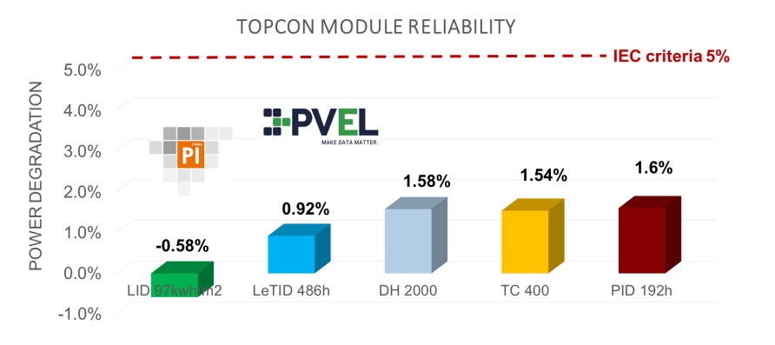
TOPCon advantages- Reliability
TOPCon module has a better performance than IEC standard, even under enhanced test sequence.
9
Notes:
TOPCon module has a better performance than IEC standard, even under enhanced test sequence. The degradation for IEC criteria is 5%, but for Topcon modules, even in enhanced test condition, the degradation is less than 2%.

Slide 10
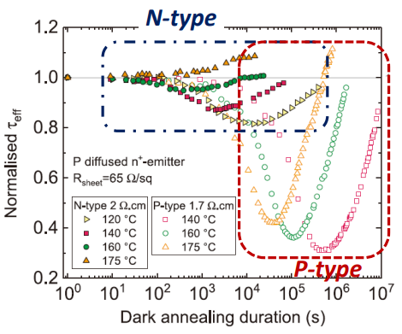
TOPCon advantages- Reliability
The solubility of hydrogen in n-type wafers to be significantly lower than in p-type
Hydrogen in p type cell will form B-H pairs and in n type cell will form P-H pair. Under illumination, P-H pair is easier to break and release the hydrogen
The release hydrogen is easier to diffuse out of silicon wafer for N type cell
10
Notes:
Our customers usually pay attention to letid, so I would try to explain it.
LeTID stands for Light and Elevated Temperature Induced Degradation. Compared with LID, Letid has slower degradation rate, and often happen when the temperature is over 50℃.
Hydrogen plays an important role in causing LeTID. Some hydrogen is filled in the silicon nitride, in the manufacture process of anneal, the hydrogen will be released into silicon to form recombination center with impurities, leading to the cell efficiency falling.
However, due to the material characteristics, the solubility of hydrogen in n-type wafers to be significantly lower than in p-type, which means less hydrogen would indiffuse into the n-Si bulk than p-Si during firing process(/ˈfaɪərɪŋ/). In addition, the hydrogen is easy to release out the N type silicon. Therefore, the Topcon modules perform better in preventing letid.
The Letid degradation in about 0.9% to 1.2% for PECR cells, but for Topcon cells, it is normally 0.4%. (162hours).

Slide 11
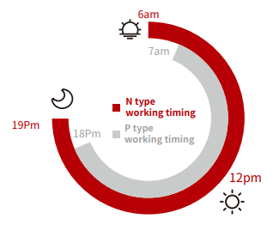
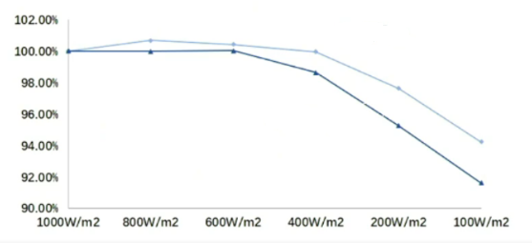
TOPCon advantages- Better weak illumination response
Longer lifetime of minority carriers
Higher shunt resistance
N type product
P type product
11
Notes:
As we mentioned above, the better weak illumination response contributes higher bifaciality of Topcon modules, because of its longer lifetime of minority carriers and higher shunt resistance.
Compared with perc module, this advantage also expands approximately one hour generating time in the morning and dusk. And on cloudy or foggy days, more power can be generated by N type cells than P type cells.
As we can see in the graph, especially the illumination is under 600W/m2, the degradation of Topcon module efficiency is apparently less than perc

Slide 12
TOPCon module- High value return
Item | Unit | PERC bifacial | TOPCon bifacial
Annual effective irradiation hours | h/year | 1200 | 1200 | 1200
Module power | Wp | 450 | 460 | 465
Module price | $/Wp | 0.279 | 0.304 | 0.306
Effective power | Wp | 411 | 429 | 434
Total cost per watt in life (discounted) | $/Wp | 0.782 | 0.802 | 0.801
Initial investment per watt | $/Wp | 0.729 | 0.749 | 0.749
BoS | $/Wp | 0.45 | 0.446 | 0.444
LCOE | $/kWh | 0.0369 | 0.0369 | 0.0369
Suppose the LCOE is the same,
N-TOPCon module has a extra value of 2.5 ~ 2.65 USC/Wp Vs. P-PERC module.
1MW project, Germany
NTOPCon module bifaciality 75%, temperature
coefficient -0.30%/℃, 1st year degradation 1%,
annual degradation 0.4%
PERC module:, bifaciality 65%， temperature
coefficient -0.34%/℃， 1st year degradation 2%，
annual degradation 0.45
12
Notes:
Let’s come to the high value return.
1 MW project, using the modules with the same structure, only difference is cell technology, due to the power advantages, Topcon has 10W higher, due to other influence, such as temperature, the power may be lower. PERC power reduce to 411, Topcon 429. As we all kwon, the price of Topcon is higher, about 2.5 US than perc, so the total cost per in life and initial investment per watt is increased.
However, when we come to BOS, the cost of Topcon is less, because of its power advantages, less modules will be used, which means the cables, the land, the racks and the labor cost will drop a lot. Finally, we see the LCOE (Levelized Cost of Energy) is same. At this point, we can suppose, if the price difference between Topcon and Perc is less than 2.5 cents, the LCOE of Topcon will drop. So, the 2.5 cents is the value return, we can take to our customers.

Slide 13
TOPCon module- High value return
Item | Unit | PERC bifacial | TOPCon bifacial
Annual effective irradiation hours | h/year | 1650 | 1650 | 1650
Module power | Wp | 545 | 545 | 575
Module price | $/Wp | 0.272 | 0.293 | 0.31
Effective power | Wp | 502 | 514 | 542
Total cost per watt in life (discounted) | $/Wp | 0.896 | 0.919 | 0.917
Initial investment per watt | $/Wp | 0.722 | 0.743 | 0.750
BoS | $/Wp | 0.45 | 0.45 | 0.439
LCOE | $/kWh | 0.0296 | 0.0296 | 0.0296
Suppose the LCOE is the same,
For the same Module power, NTOPCon module has a extra
value of 2.1 USC/Wp Vs. P-PERC module.
NTOPCon module has a higher power of 30W, which brings a premium of 3.8 USC/W.
50MW project, Spain
NTOPCon module bifaciality 80%, temperature
coefficient -0.30%/℃, 1st year degradation 1%,
annual degradation 0.4%
PERC module:, bifaciality 70%， temperature
coefficient -0.34%/℃， 1st year degradation 2%，
annual degradation 0.45
13
Notes:
For large project, we utilize HD144N modules as an example, with the same rated power, 545w, although the price of Topcon module is 1.9 dollar cents more than perc module, at last, their LCOE is the same, because Topcon modules has higher effective power. So for the same power, Topcon module can give customers a value of 1.9 dollar cents. If the power difference up to 30W, the extra value is 3.5 USC/W.

Slide 14
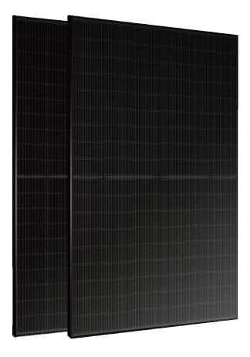
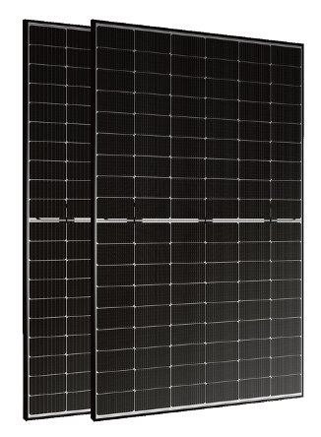
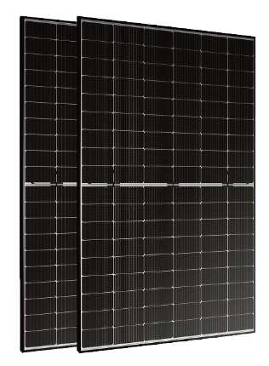
Products-Residential roof
Black
Pro
Light
Maximum power: 425W
Maximum efficiency: 21.76%
Real black modules
Type: HD108N-M10
HT108N-M10
Maximum power: 430W
Maximum efficiency: 22.02%
Type: HD108N-M10
Maximum power: 430W
Maximum efficiency: 22.02%
Weight: 21.5kg
Type: HT108N-M10
14
Notes:
For residential, HD120N, HD108N and HT108N is our main products. HD means double glass module, HT means single glass module. HD120N is based on M6 size wafer and 108 half-cell module is based on M10 wafer. The maximum power for 120 half cell module is 385W and for 108 cell module is 420W. For the full black modules with some type, the power may be 10W lower.

Slide 15
Products-Residential roof
Series | Type | structure | String Connector | Cell Type | Frame | Dimension
Niwa Pro | HD108N | Front: AR coating glass Back: white glazed grid glass | Silver | M10 | Black | 1722*1134*30mm
Niwa Light | HT108N | Front: AR coating glass Back: White backsheet | Silver
Niwa Black | HD108N-full black | Front: AR coating glass Back: Transparent glass | Black
 | HT108N-full black | Front: AR coating glass Back: backsheet with black cell side and white air side | Black
15
Notes:
For residential, HD120N, HD108N and HT108N is our main products. HD means double glass module, HT means single glass module. HD120N is based on M6 size wafer and 108 half-cell module is based on M10 wafer. The maximum power for 120 half cell module is 385W and for 108 cell module is 420W. For the full black modules with some type, the power may be 10W lower.

Slide 16
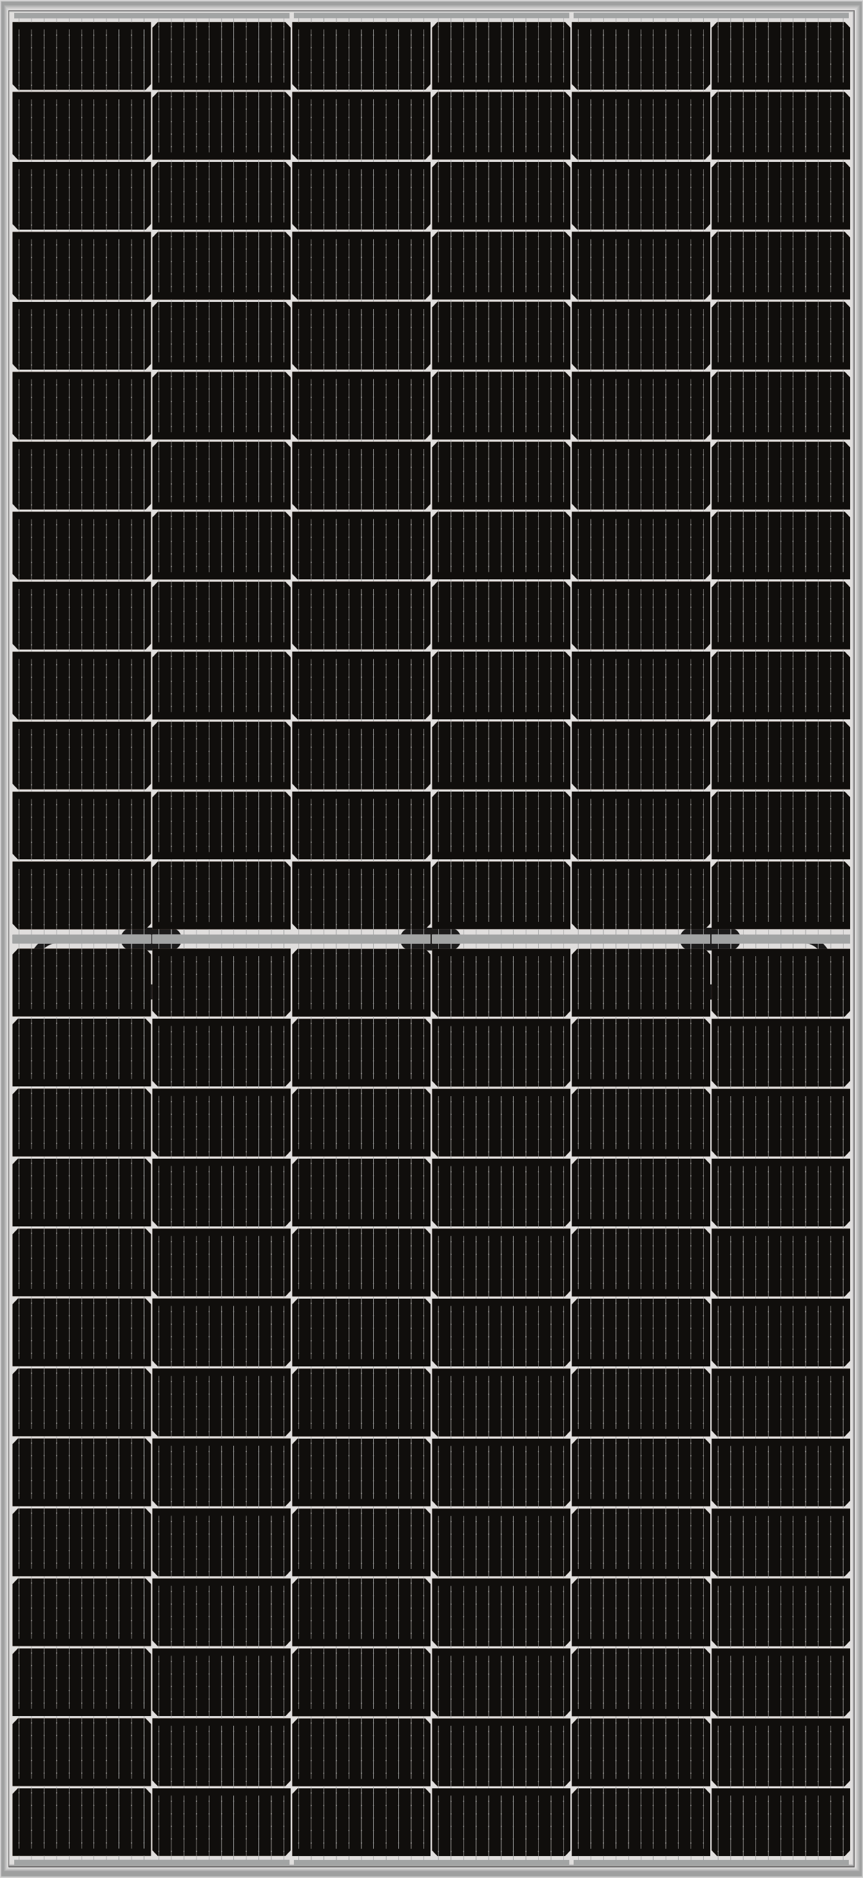
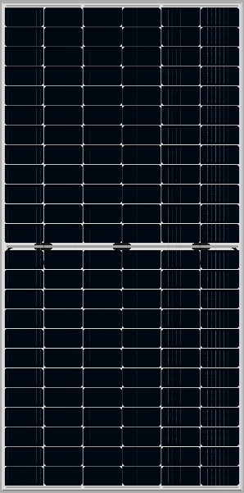
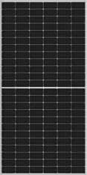
Products- Commercial and utility-scale plant
JW
JW Pro
JW Pro
Maximum power: 465W
Maximum efficiency: 21.36%
Type: HD144N-M6
Maximum power: 630W
Maximum efficiency: 22.53%
Type: HD156N-M10
Maximum power: 580W
Maximum efficiency: 22.45%
Type: HD144N-M10
16
Notes:
For Commercial and utility-scale plant. We have three products. HD144N, which is based on M6 wafer, the maximum power is 465W,. HD156N and HD144N are based on M10 wafer, the maximum power is 615W and 570W respectively.

Slide 17
Products- Commercial and utility-scale plant
 | Type | Cell Type | Dimension | structure | String Connector | Frame
JW | HD144N | M6 | 2095*1039*30 | Front: AR coating glass Back: white glazed grid glass | Silver | Silver
JW Pro | HD144N | M10 | 2278*1134*30
 | HD156N | M10 | 2465*1134*30
17
Notes:
For Commercial and utility-scale plant. We have three products. HD144N, which is based on M6 wafer, the maximum power is 465W,. HD156N and HD144N are based on M10 wafer, the maximum power is 615W and 570W respectively.

Slide 18

THANK YOU
www.jolywood.cn
Leader of n-type bifacial technology

